Slide 1

CYBERVERSE: An Integrated Cybersecurity Platform Compared with Traditional Security Tools for Comprehensive Threat Detection and Analysis
Guided by:
Dr. Ponmaniraj S
Professor
Department of Computer Science
Presented by:
Mohamed Haroon P (192511313)
Anbalagan M (192565059)
S.Santhoshkumar (192512271)
CSA0808: Python Programming

Slide 2


Abstract
CyberVerse-AI is a centralized web-based cybersecurity platform designed to integrate multiple security analysis functions into a single application. It provides users with password analysis, URL threat scanning, email analysis, file integrity checking, security reporting, and dashboard-based monitoring. The platform follows a modular Flask architecture with Python as the backend, MySQL for database management, and HTML, CSS, and JavaScript for the frontend. By combining these security workflows with common authentication and administrative features, CyberVerse-AI provides a practical foundation for demonstrating and extending cybersecurity analysis in one user-friendly platform.

Slide 3
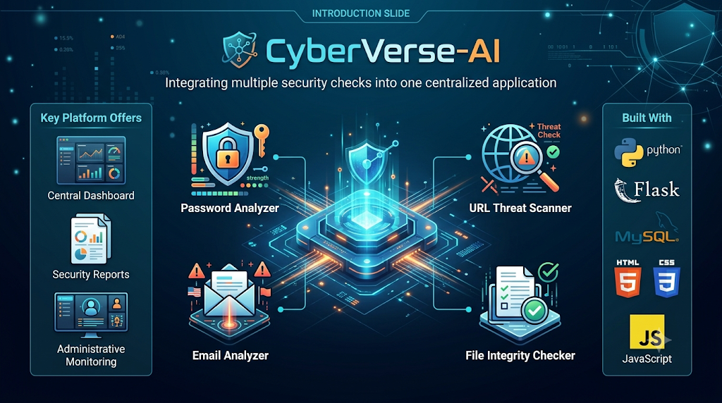
Introduction
CyberVerse-AI is a web-based cybersecurity analysis and monitoring platform.
It integrates multiple security checks into one centralized application.
Provides Password Analyzer, URL Threat Scanner, Email Analyzer, and File Integrity Checker.
Offers a central dashboard, security reports, and administrative monitoring.
Built using Python, Flask, MySQL, HTML, CSS, and JavaScript.

Slide 4
⚠️ Problem Statement
Security checks for passwords, URLs, emails, and downloaded files are often performed using separate tools.
This creates fragmented workflows and makes security analysis less convenient.
Users have limited centralized visibility of security assessments and activities.
Different security tasks may require different tools and workflows.
CyberVerse-AI addresses this problem by integrating multiple security-analysis functions into one platform with common authentication, dashboard, and reporting capabilities.

Slide 5
📖 Literature Review
Year | Author(s) | Title | Method Used | Contributions & Limits Addressed
2022 | P. Kumar, R. Sharma | Heuristic Password Entropy & Dictionary Pattern Evaluation | Shannon Entropy & N-gram Pattern Matching | Traditional checkers only checked length. Resolved by adding character diversity and dictionary attack heuristics.
2022 | M. Al-Sarem et al. | Lexical & Heuristic Feature-Driven URL Phishing Detection | Lexical Parsing & Domain Heuristic Scoring | Relied heavily on slow live DNS blacklists. Resolved using instant client-side lexical extraction and risk scoring.
2023 | S. Verma, D. K. Yadav | Header and Semantic NLP Email Threat Analysis | NLP Keyword Extraction & Header Anomaly Scanning | Lacked combined header-body inspection. Resolved by multi-layer parsing of SPF/DKIM flags and phishing indicators.
2023 | A. J. Mendez et al. | Lightweight File Integrity Verification in Web Systems | Cryptographic Hash Verification | High computational overhead on large files. Resolved using chunked stream hashing and reference fingerprint matching.
2024 | T. H. Nguyen, L. Chen | Unified Security Dashboard Architecture for SMBs | Flask Blueprints & REST APIs | Fragmented standalone security scripts. Resolved by integrating multi-module feeds into a single session-authenticated view.
2024 | B. K. Patel et al. | Centralized Threat Reporting & Incident Logging Systems | Relational DB & Asynchronous Export | Lacked unified export formats. Resolved by introducing instant CSV/PDF reporting tied to assessment history logs.
2025 | CyberVerse Team | Integrated Web-Based Cybersecurity Platform | Modular Micro-Engine Pipeline | Solves workflow fragmentation across password, URL, email.

Slide 6
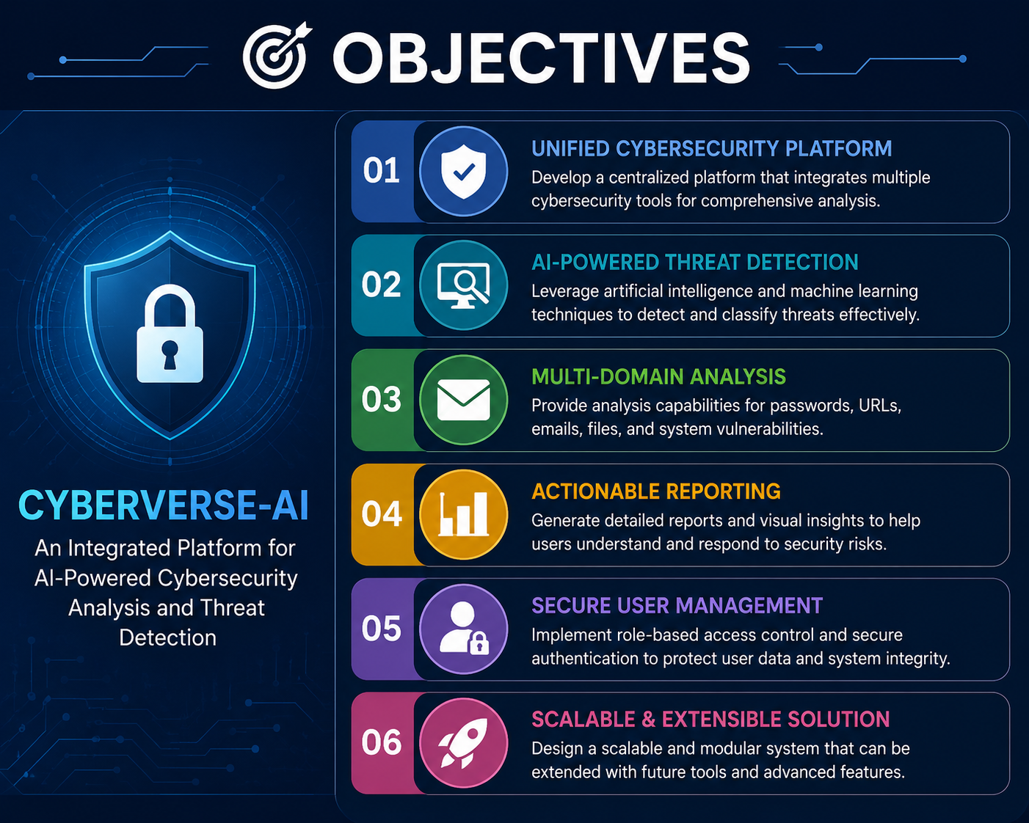
🎯 Project Objectives
Provide one centralized interface for multiple cybersecurity analysis tasks.
Analyze password strength and provide security recommendations.
Assess URLs for potentially suspicious or malicious characteristics.
Analyze emails for phishing and other security risks.
Verify file integrity using cryptographic hashes and provide security reports.

Slide 7
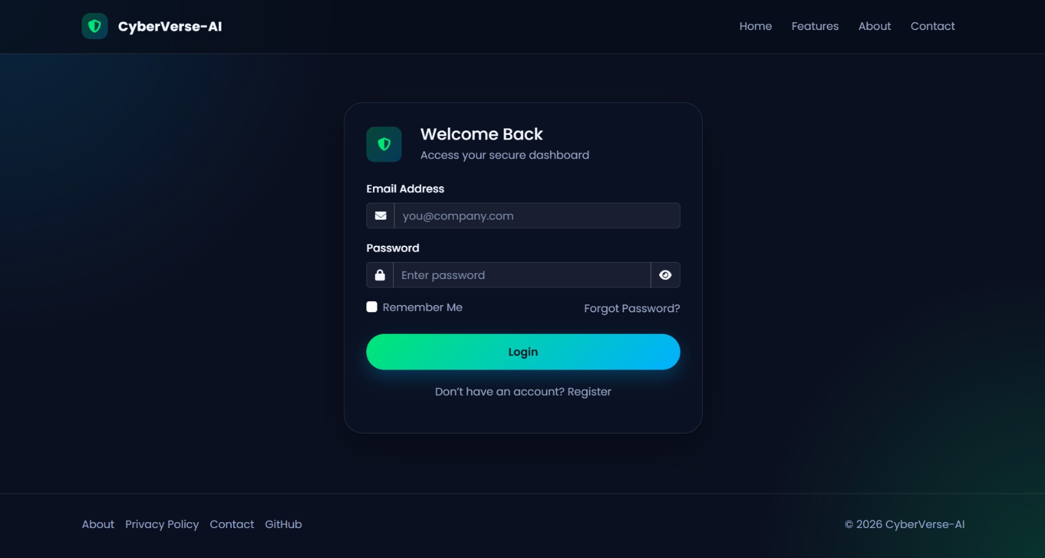
MODULE 1: User & Authentication
User Registration – Allows new users to create an account and securely enter the platform.
Login & Logout – Authenticates registered users and provides controlled session access.
Session Management – Maintains the user’s authenticated session while using the application.
Protected Dashboard – Ensures only logged-in users can access the main dashboard and security features.
Access Control – Prevents unauthorized users from accessing protected pages and functions.

Slide 8
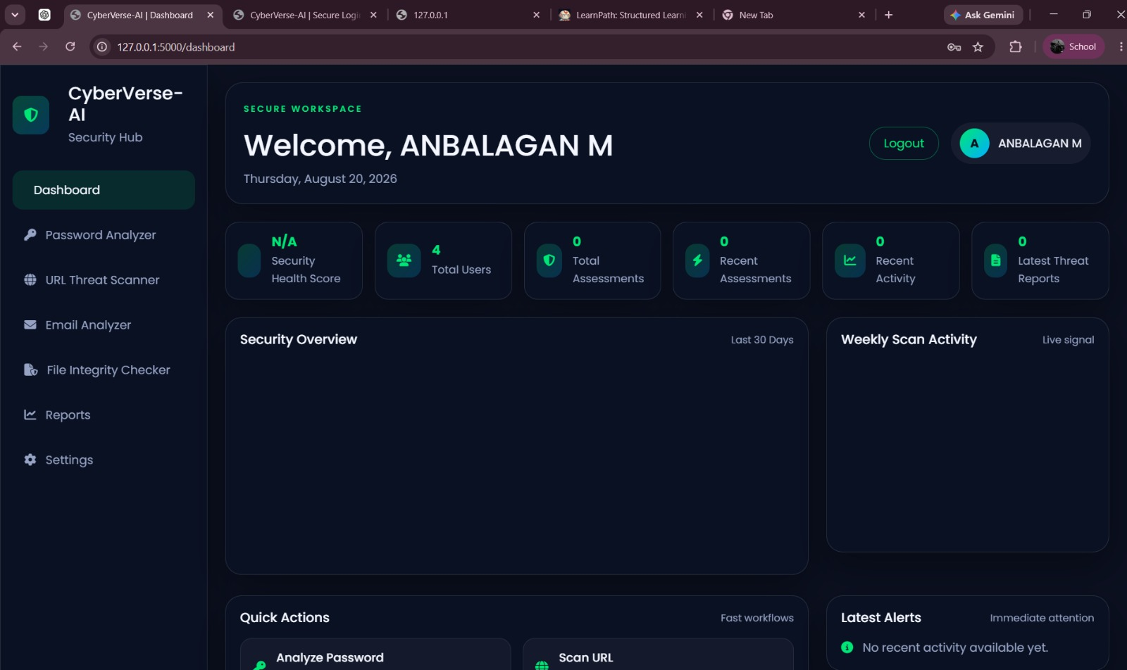
MODULE 2: Security Analysis Module
Password Analyzer – Evaluates password strength, patterns, character composition, and provides security recommendations.
URL Threat Scanner – Analyzes URLs for suspicious characteristics and provides a risk assessment.
Email Analyzer – Examines email content and headers to identify phishing and other security risks.
File Integrity Checker – Uses cryptographic hashing to compare files and detect changes in file content.
Security Assessment – Combines the analysis results to provide users with clear security status and guidance.

Slide 9
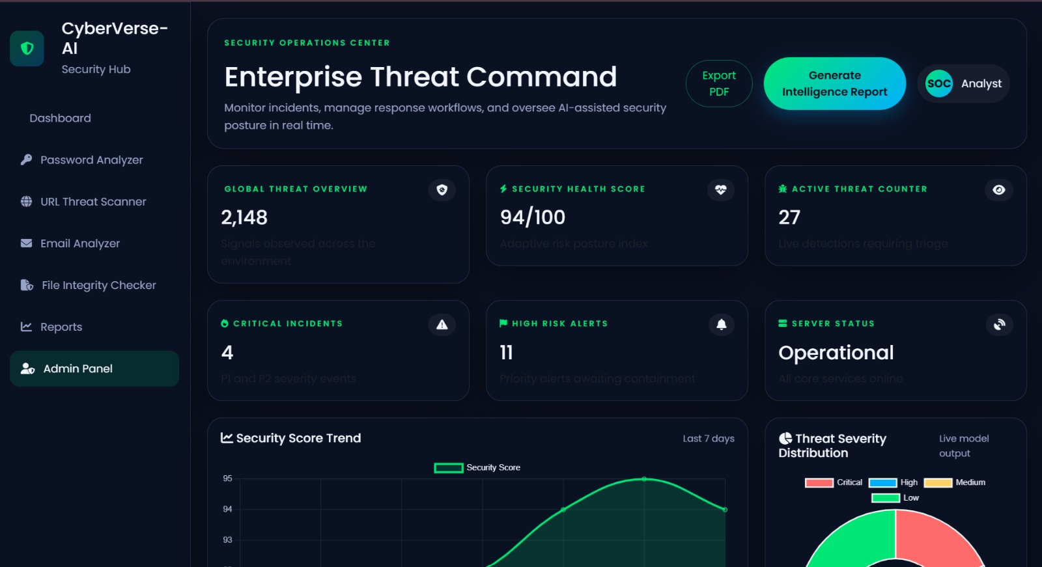
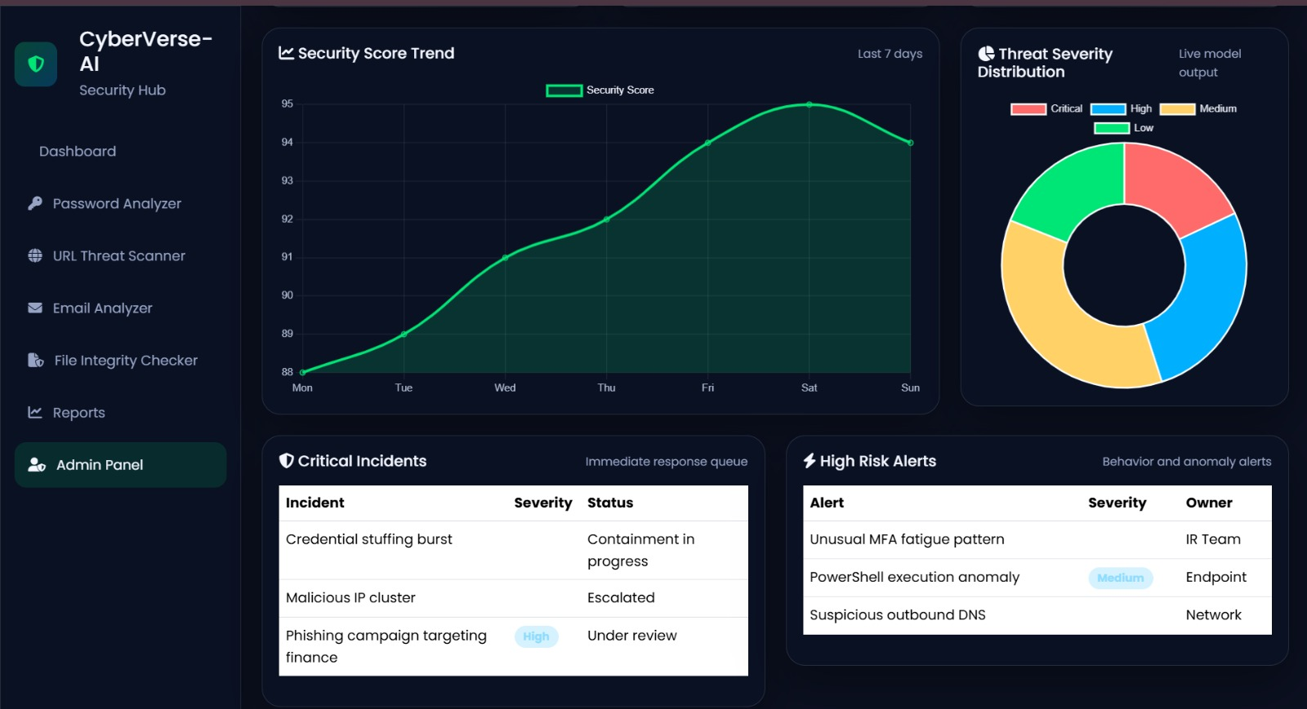
MODULE 3: Reporting & Administration Module
Security Reports – Displays security activity, threat information, and assessment results.
Report Generation – Supports generating and exporting security reports in PDF/CSV formats where implemented.
Admin Panel – Provides administrators with centralized monitoring and operational controls.
Threat Management – Includes prototype actions such as threat containment, escalation, and SOC notification where implemented.
Centralized Monitoring – Helps administrators monitor security activities and manage the platform

Slide 10
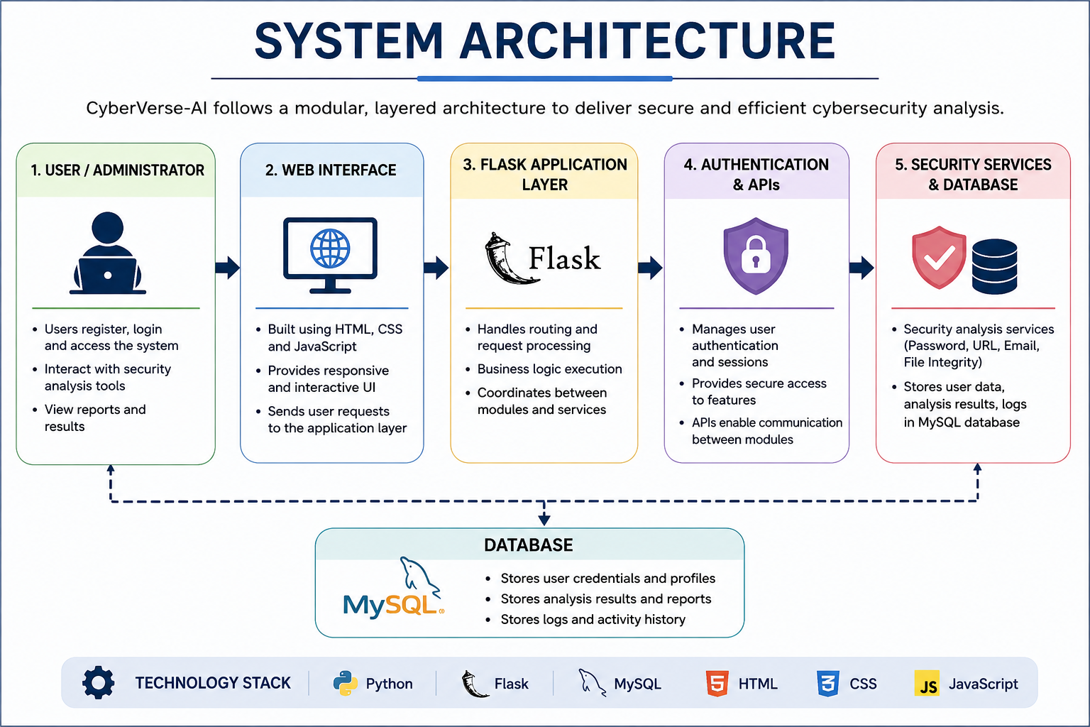
🧬 System Architecture

Slide 11
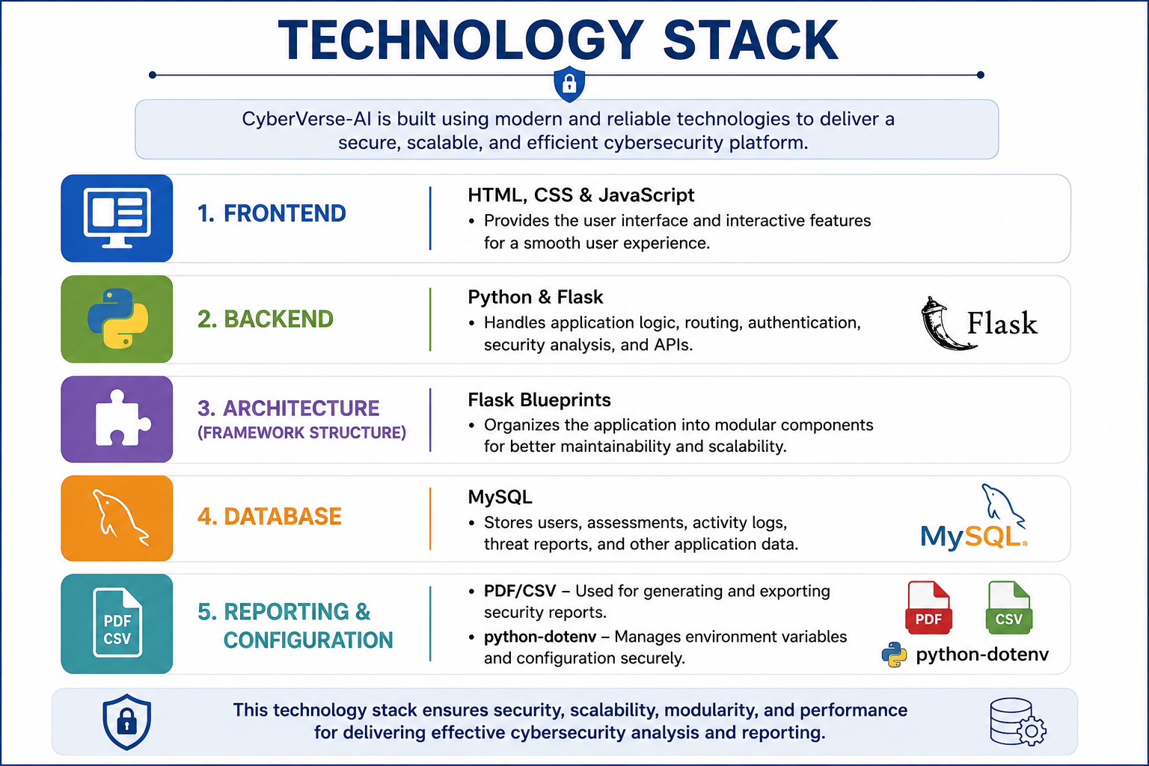
TECHNOLOGY STACK

Slide 12
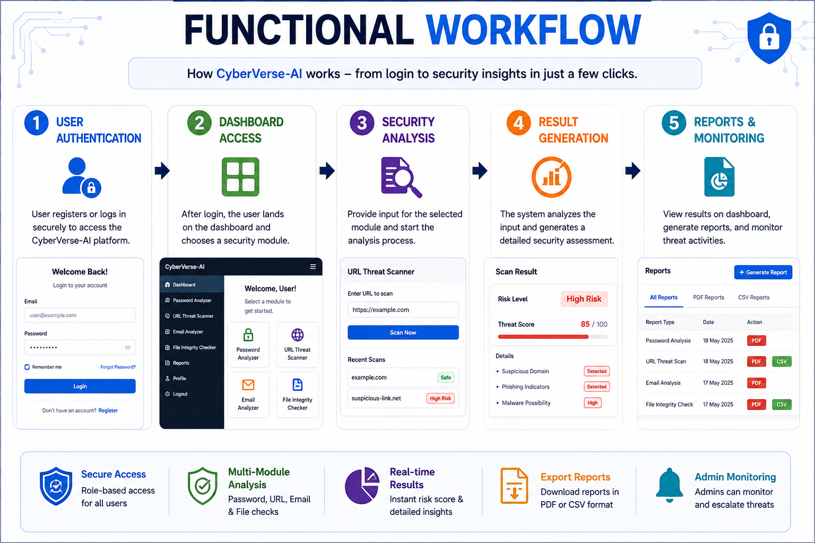
🧩 FUNCTIONAL WORKFLOW

Slide 13
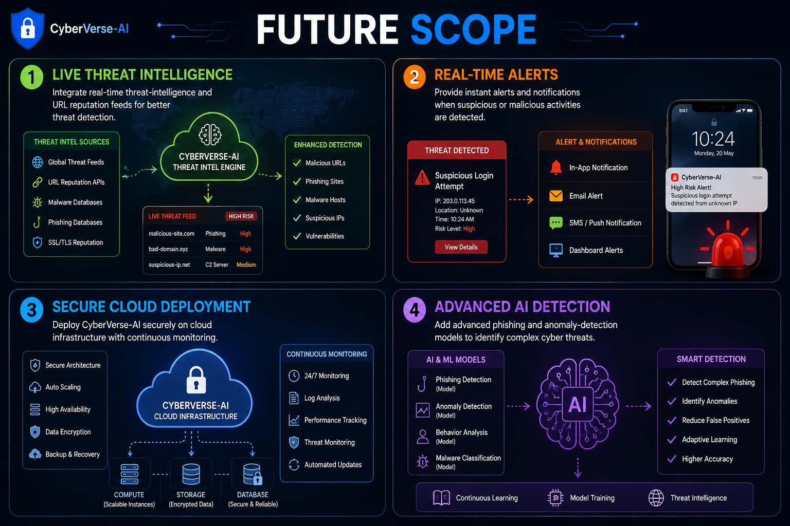
🔮 Future Scope
Live Threat Intelligence – Integrate real-time threat-intelligence and URL reputation feeds for better threat detection. Real-Time Alerts – Provide instant alerts and notifications when suspicious or malicious activities are detected. Secure Cloud Deployment – Deploy CyberVerse-AI securely on cloud infrastructure with continuous monitoring. Advanced AI Detection – Add advanced phishing and anomaly-detection models to identify complex cyber threats.

Slide 14
🏁 Conclusion
CyberVerse-AI provides a centralized and modular platform that integrates multiple cybersecurity analysis functions, including password analysis, URL threat scanning, email analysis, file integrity checking, reporting, and administration. By combining these features with authentication, a common dashboard, and a Flask-based architecture, the project offers a practical and user-friendly approach to cybersecurity analysis. The platform can be further enhanced with stronger security controls, live threat intelligence, advanced detection models, and enterprise integrations to support future production-level deployment.

Slide 15
References
Jayaprakash, R., Natarajan, K., Daniel, J. A., Chinnappan, C. V., Giri, J., Qin, H., & Mallik, S. (2024). Heuristic machine learning approaches for identifying phishing threats across web and email platforms. Frontiers in Artificial Intelligence, 7, 1414122.
Jishnu, K. S., & Arthi, B. (2024). Exploring GRU-based approaches with attention mechanisms for accurate phishing URL detection. Intelligent Decision Technologies, 18(2), 1029–1052.
Rashid, F., Doyle, B., Han, S. C., & Seneviratne, S. (2024). Phishing URL detection generalisation using unsupervised domain adaptation. Computer Networks, 245, 110398.
Patil, D. (2025). Integrating NLP and ensemble methods for large-scale phishing email detection. Intelligent Decision Technologies, 19(4), 2123–2144.
Barik, K., Misra, S., & Mohan, R. (2025). Web-based phishing URL detection model using deep learning optimization techniques. International Journal of Data Science and Analytics, 20, 4449–4471.
Gallo, L., Gentile, D., Ruggiero, S., Botta, A., & Ventre, G. (2023). The human factor in phishing: Collecting and analyzing user behavior when reading emails. Computers & Security.

Slide 16
Thank You

